Slide 1
Airline Analysis IST 387 Final
By. Alejandro Pesantez

Slide 2
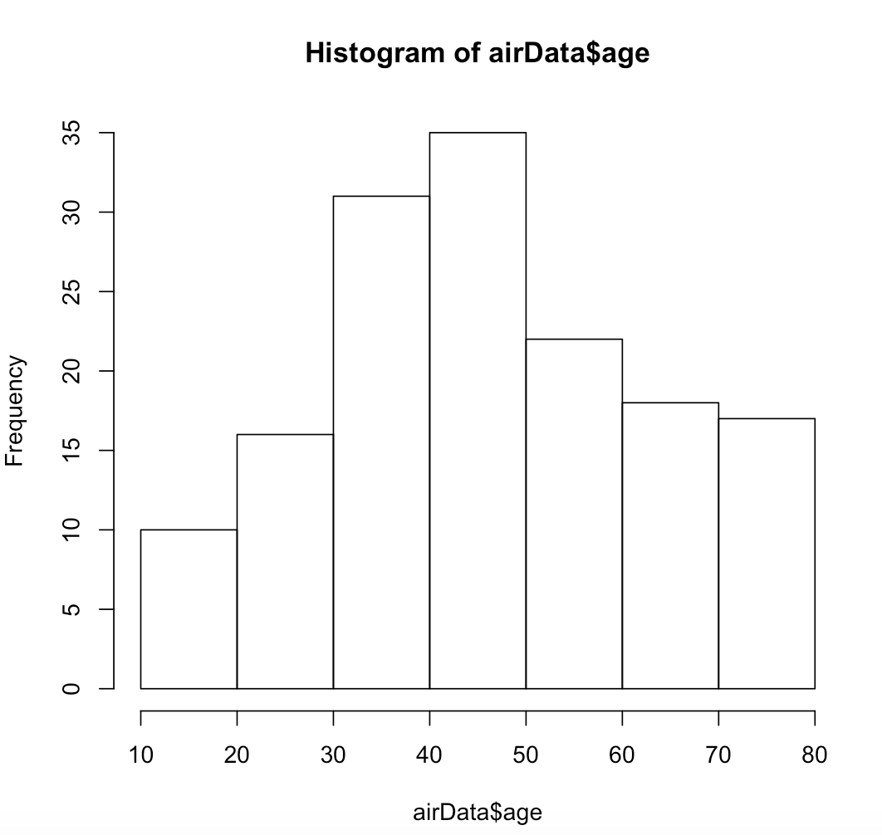
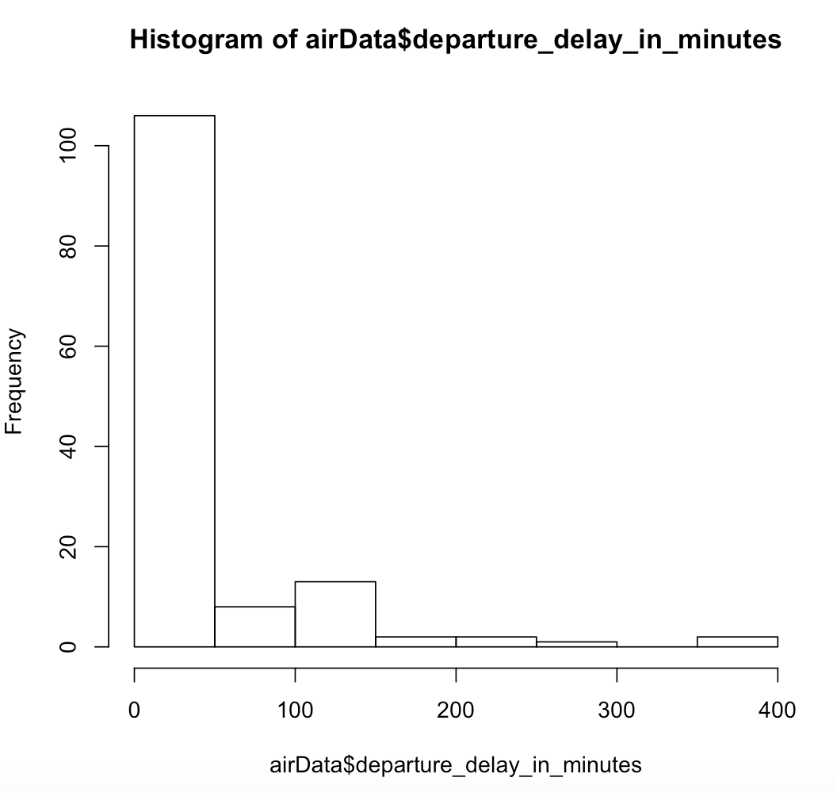
Histograms from Airline Dataset
The histogram produced is the ages of the people that rode this airline. The majority of the passengers are between the ages of 40 and 50 with the minority being between 10 and 20. The histogram is close to being normally distributed however; it is skewed a tiny bit to the left.
This histogram shows the frequency of the departure delays in minutes. This histogram shown is very much skewed to the right
and the majority of departure flights are delayed between 0 and 50 minutes, while departure flights that are delayed between 300 and 350 minutes don't exist in the dataset.
Notes:
hist(airData$age)
Creates histogram of ages
hist(airData$departure_delay_in_minutes)
Creates histogram of delays on departure flights

Slide 3
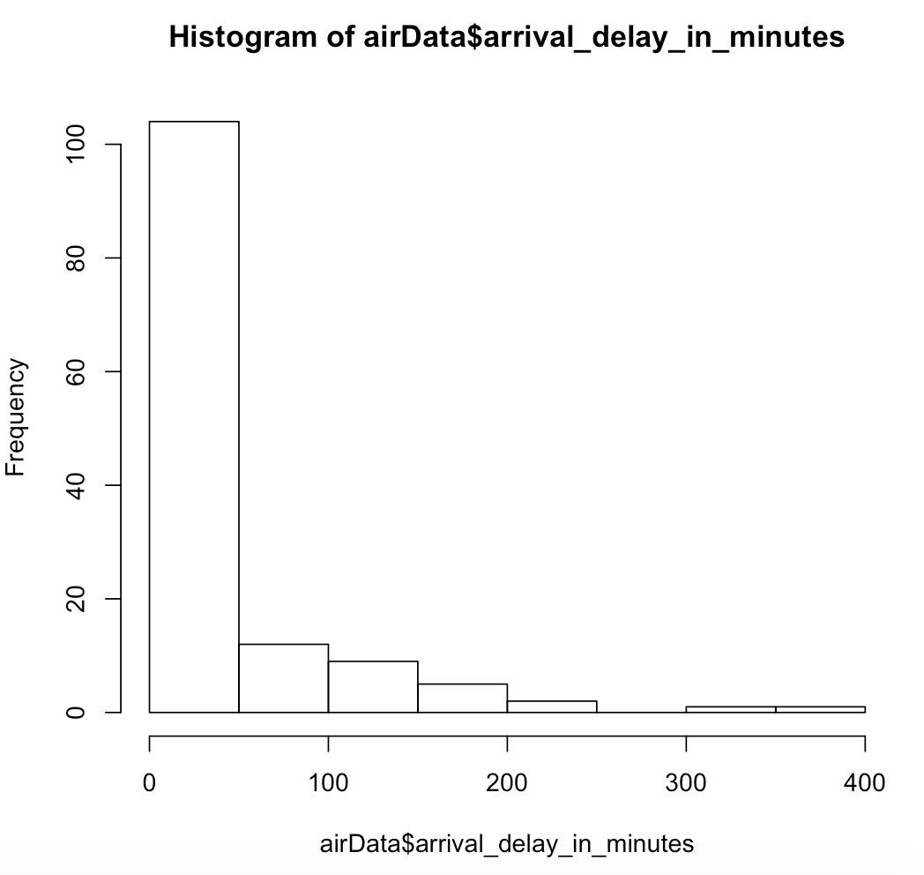
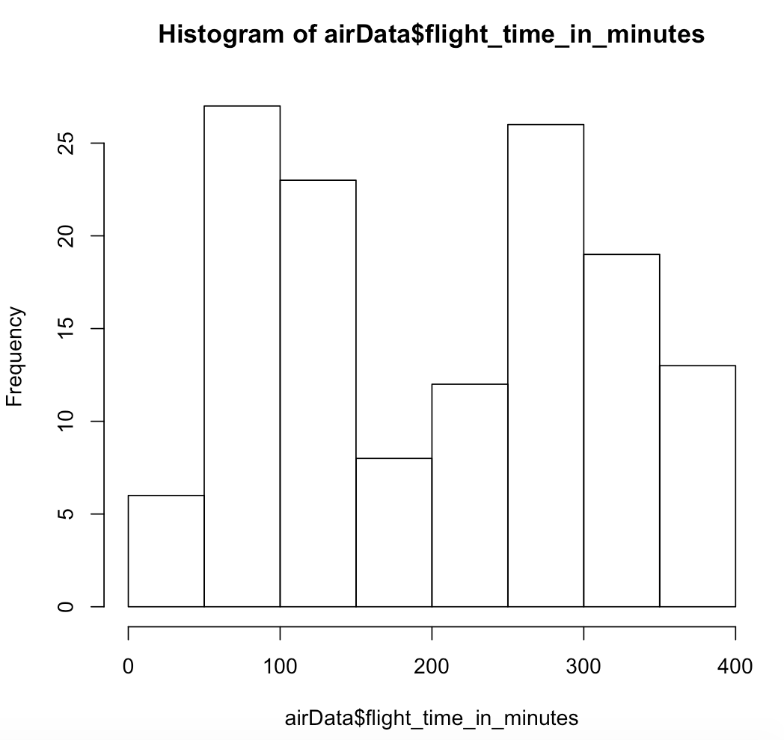
Histograms from Airline Dataset
This histogram shows the frequency of arrival delays in minutes. This is also very much skewed to the right and shows that the majority of arrival
flights that are delayed is between 0 to 50 minutes, while arrival flights that are delayed between 250 and 300 minutes don't exist.
This histogram shows the frequency of flight times in minutes. The histogram seems to have a bimodal distribution, since
there are two peaks. The histogram also shows that most flight durations are between 50 to 100 minutes while the least amount of flight durations are between 0 to 50 minutes.
Notes:
hist(airData$arrival_delay_in_minutes)
Creates histogram of delays on arrival flights
hist(airData$flight_time_in_minutes)
Creates histogram of how long flights were

Slide 4
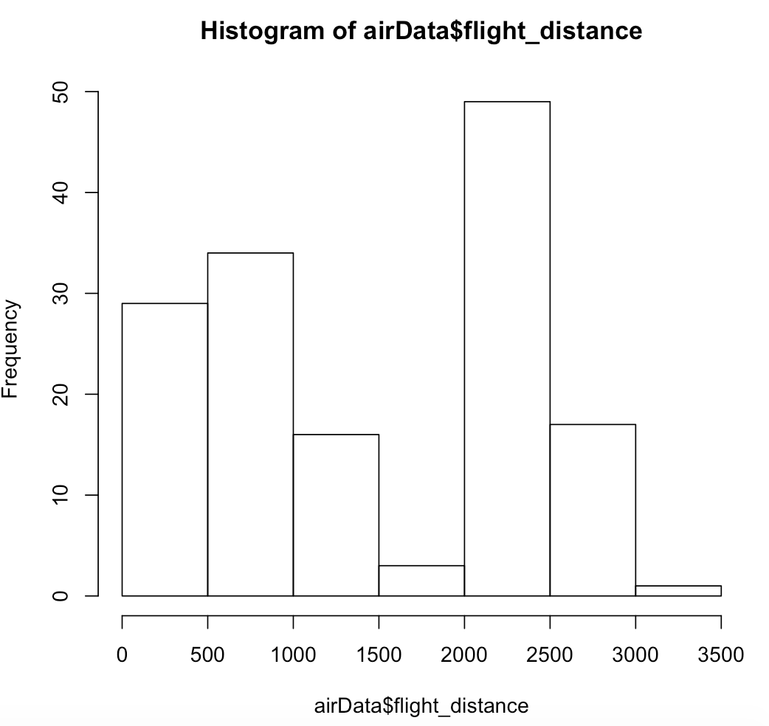
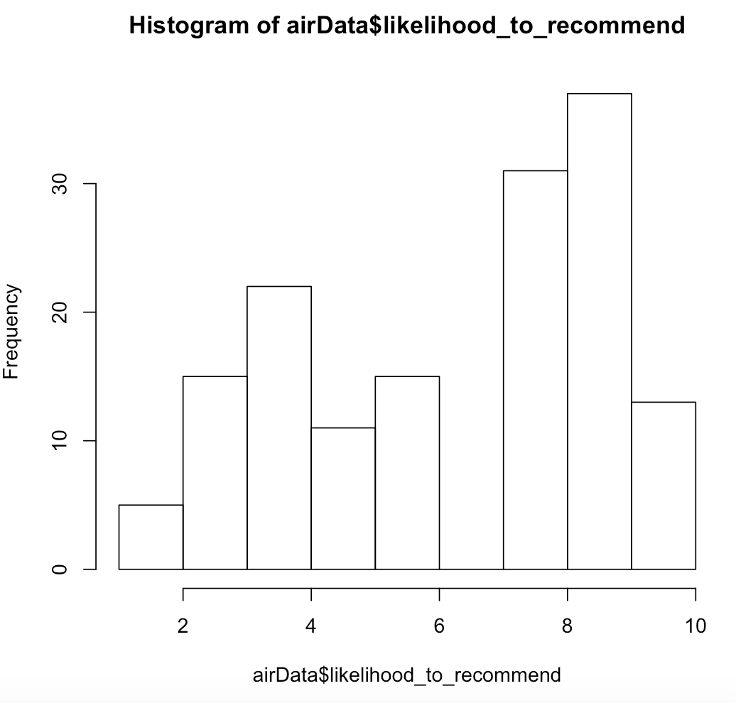
Histograms from Airline Dataset
This histogram shows the frequency of flight distances. In this case there really isn't any pattern of the distribution of the data given.
It shows that most flights are around 2000 to 2500 miles, while the least amount of flights are around 3000 to 3500 miles.
This histogram shows the frequency of how people rated their likelihood of recommending this airline to someone. It's hard to tell if there is a pattern in this distribution, if anything it seems as if it is skewed to the left. It also shows that the majority of people gave a rating of a 9 which means it is probably a very good airline, while the least amount of people gave a rating of 7.
Notes:
hist(airData$flight_distance)
Makes histogram of the distance of the flights
hist(airData$likelihood_to_recommend)
Makes a histogram of how passengers rated how likely they'd recommend this airline

Slide 5
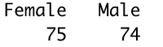
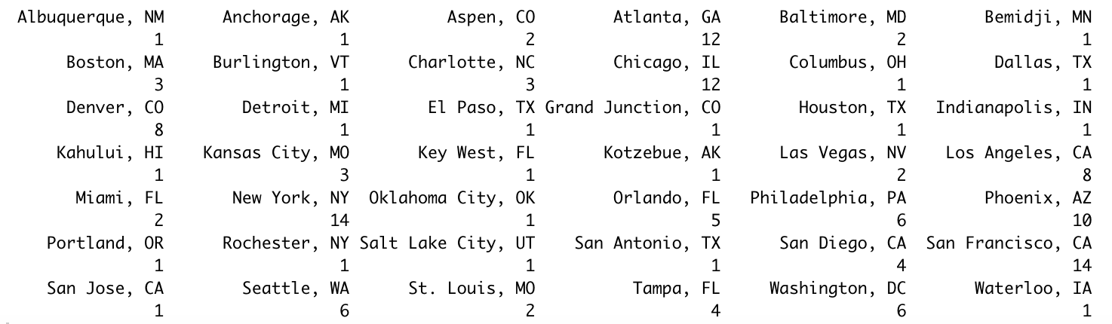
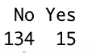
Tables from Airline Dataset
This shows where people traveled to the most. It seems as if the most common destinations were San Francisco and New York City which were tied at 14.
When looking at this table it produces how many male and female passengers there were. It seems as if they were pretty
even with 75 females and 74 males.
This is a table showing how many flights were cancelled in the data set. This shows that out of the 149 flights in the dataset only 15 were cancelled while the other 134 were not.
Notes:
table(airData$gender)
Creates table of how many males and females were in dataset
table(airData$destination_city)
Creates table of how what cities people traveled to, and the amount of occurrences of each
table(airData$flight_cancelled)
Creates table of how many flights were canceled and not

Slide 6
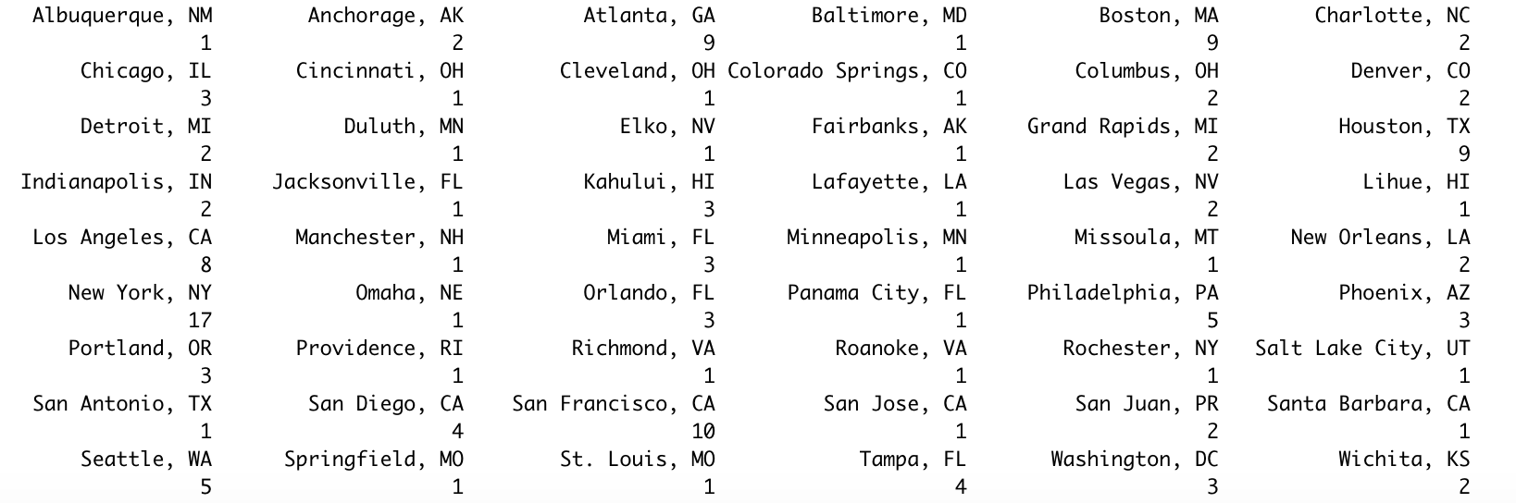
Tables from Airline Dataset
This shows where most people traveled from. This table shows that the most common place people traveled from was New York City with 17.
This table shows what was the most common type of travel. It shows that most people traveled for business purposes with 75, and the next most common was for personal travel with 60, and the least common way of travel was with mileage tickets with 14.
Notes:
table(airData$origin_city)
Creates table showing the occurrences of where people traveled from
table(airData$type_of_travel)
Creates table showing occurrences of what type of travel passengers were doing

Slide 7
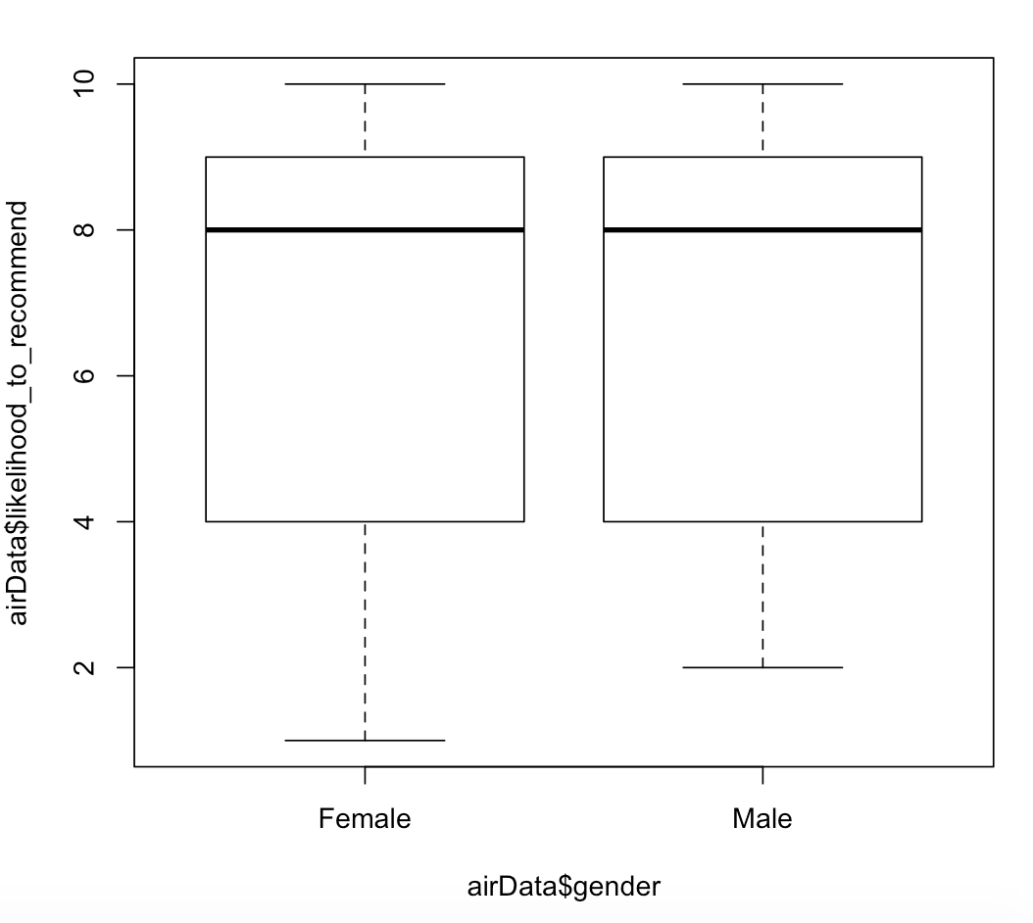
Boxplots from Airline Dataset
This shows a boxplot of how genders gave their likelihood of recommending this airline. The median of both female and male is 8, however the minimum for females was lower than that of males, meaning the worst rating a female gave was worse than the worst rating a male gave.
Notes:
boxplot(airData$likelihood_to_recommend~airData$gender)
Creates boxplot of genders compared to the likelihood of recommending this airline

Slide 8
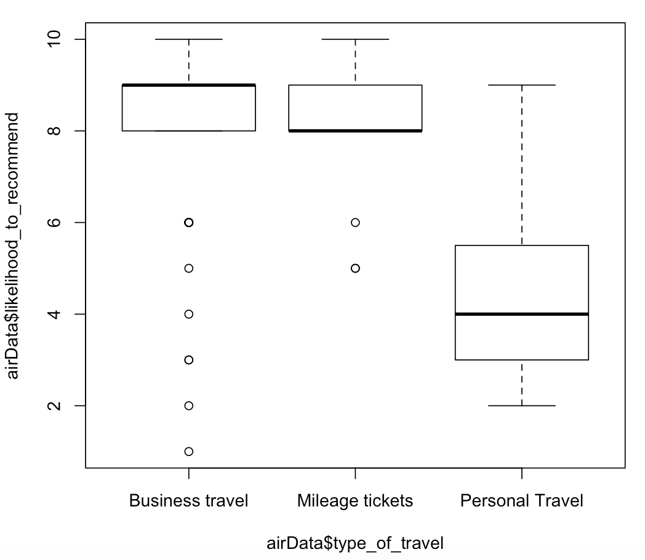
Boxplots from Airline Dataset
This boxplot shows how the difference in travel effected the ratings of how likely people were to recommend this airline. This shows that people who traveled for business were most likely to recommend this airline because the median of the boxplot is higher than the rest, while people who traveled using mileage tickets were second most likely to recommend this airline because their median was only 1 rating lower than business travel. Last but not least people who traveled for vacations were least likely to recommend this airline because their boxplot is lower than the others and their median rating is 4 ratings below those who traveled using mileage tickets.
Notes:
boxplot(airData$likelihood_to_recommend~airData$type_of_travel)
This creates a boxplot of the type of travel passengers did and comparing it to their likelihood to recommend this airline

Slide 9
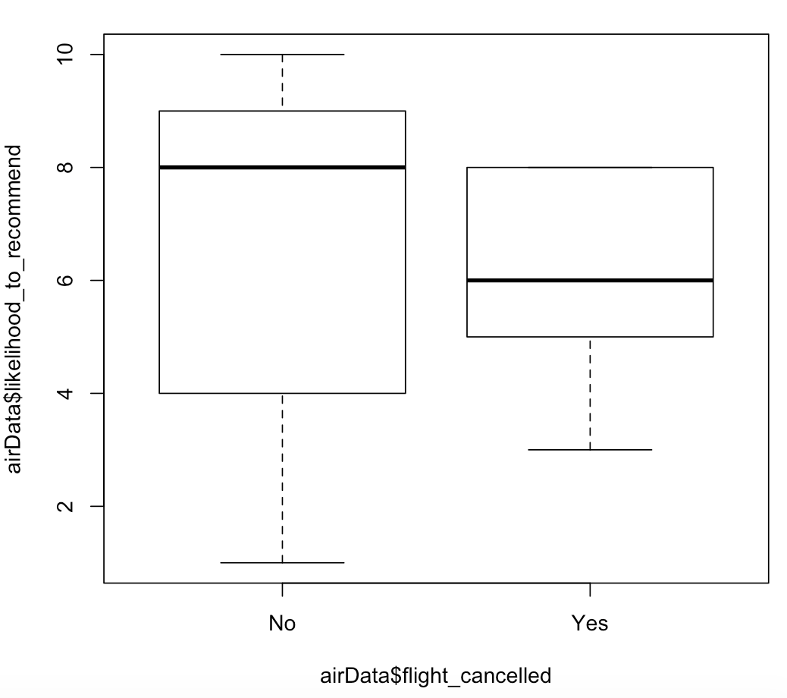
Boxplots of Airline Dataset
This boxplot shows how people with their flight being canceled versus it not being canceled rated their likelihood of recommending this airline. People that didn't get their flight canceled had a median rating of 8 and have a generally higher up boxplot than those who did get their flight cancelled. People that did get their flight cancelled had a median rating of 6 and is lower than the other boxplot. This surprised me because I thought their median rating would be much lower.
Notes:
boxplot(airData$likelihood_to_recommend~airData$flight_cancelled)
This creates a boxplot of whether or not a passengers flight was cancelled, and their likelihood of recommending the airline

Slide 10
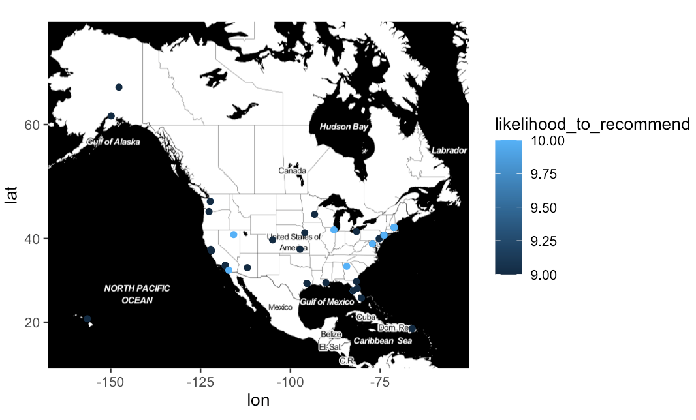
Map of the Origin Location of Airline Promoters
This is a map of where our passengers who gave us a rating of 9 or above, on how likely they would recommend this airline, are from. As you can see it seems as if these types of passengers are located in the big cities such as New York, Los Angeles, and Chicago.
Notes:
promoters <- airData %>% filter(likelihood_to_recommend > 8)
creates new data frame with only rows that have a likelihood to recommend that are greater than 8
library(ggplot2)
library(ggmap)
usmap <- get_stamenmap(bbox=c(left=-167.50, bottom=7.45, right=-50.19, top=71.58),
zoom=3, maptype = "toner")
gets map of the usa
ggmap(usmap) + geom_point(data=promoters, aes(x=olong, y=olat,
color=likelihood_to_recommend))
creates map of origin cities that are in the promoters dataset created above, and then is shaded by their likelihood to recommend

Slide 11
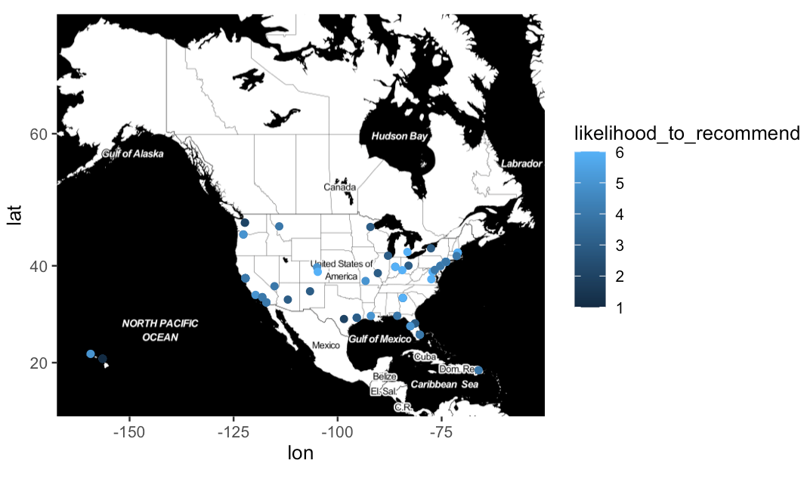
Map of the Origin Location of Airline Detractors
This is a map of where our passengers who gave us a rating of 6 or below, on how likely they would recommend this airline, are from. As you can see it seems as if these types of passengers are mostly located on the coasts and near the water, such as Hawaii, Florida, New York and California.
Notes:
detractors <- airData %>% filter(likelihood_to_recommend < 7)
creates new data frame with only rows that have a likelihood to recommend that are less than 7
library(ggplot2)
library(ggmap)
usmap <- get_stamenmap(bbox=c(left=-167.50, bottom=7.45, right=-50.19, top=71.58),
zoom=3, maptype = "toner")
gets map of the usa
usmap <- get_stamenmap(bbox=c(left=-167.50, bottom=7.45, right=-50.19, top=71.58),
zoom=3, maptype = "toner")
ggmap(usmap) + geom_point(data=detractors, aes(x=olong, y=olat,
color=likelihood_to_recommend))
creates map of origin cities that are in the detractors dataset created above, and then is shaded by their likelihood to recommend

Slide 12
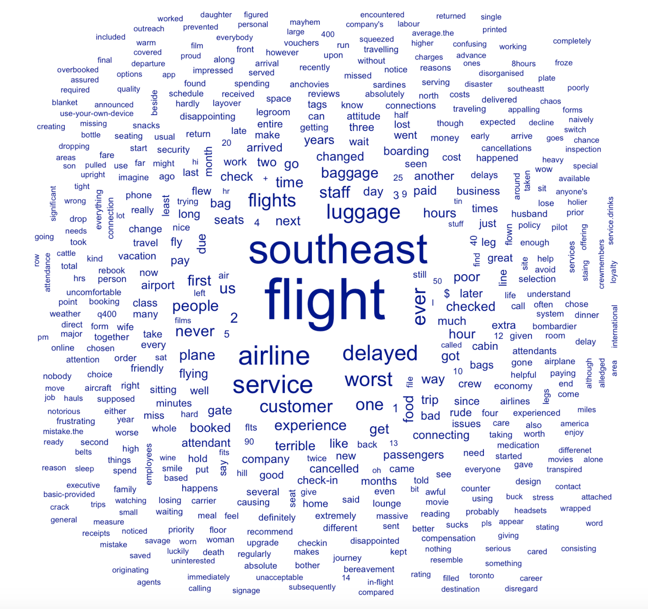
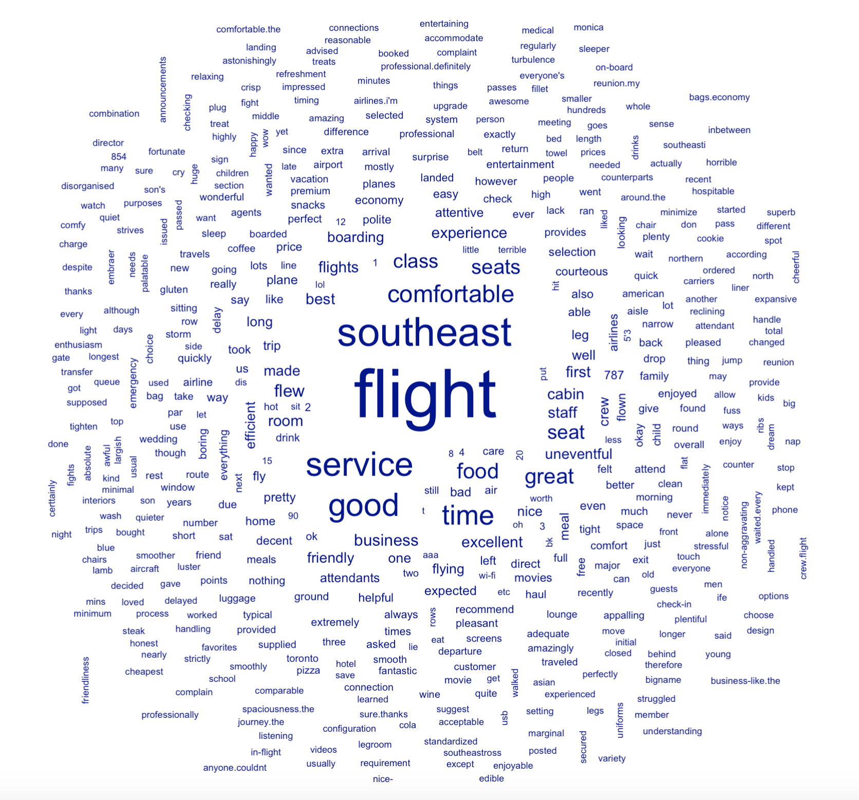
Word Clouds from Airline Reviews
Detractors:
Promoters:
It seems to me that most of the detractors are unhappy about the service they get, their flight might’ve been delayed, or something went wrong with their luggage.
Here it seems as if the promoters really liked the comfortability they had on their flights. This includes their seating, the food, and even the service.
Notes:
library(quanteda)
detractCorpus <- corpus(detractors$free_text)
this creates a corpus of the text written by detractors
promoteCorpus <- corpus(promoters$free_text)
this creates a corpus of the text written by promoters
detract_dfm <- dfm(detractCorpus,remove_punct = TRUE, remove = stopwords('english'))
makes a document feature matrix of the words in our detract corpus and removes punctuation and stop words.
promote_dfm <- dfm(promoteCorpus,remove_punct = TRUE, remove = stopwords('english'))
makes a document feature matrix of the words in our promote corpus, and removes punctuation and stop words.
textplot_wordcloud(detract_dfm, min_count = 1)
this creates a word cloud of the document feature matrix from the detractors, with the word only having to appear once.
textplot_wordcloud(promote_dfm, min_count = 1)
this creates a word cloud of the document feature matrix from the promoters, with the word only having to appear once.

Slide 13
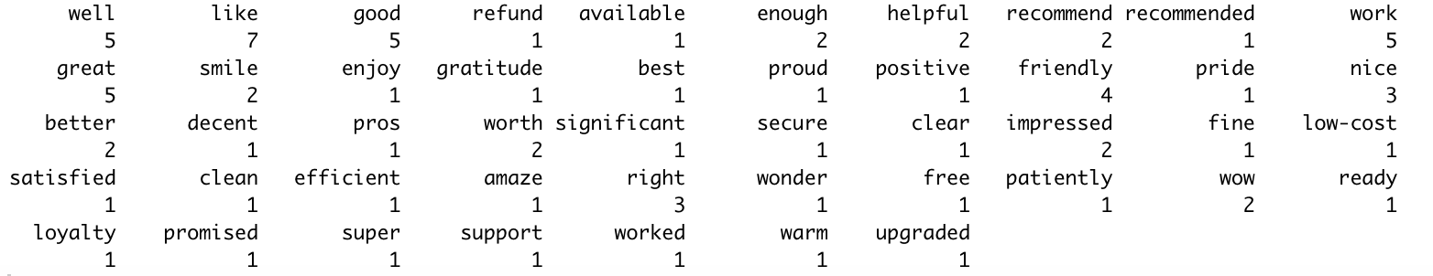
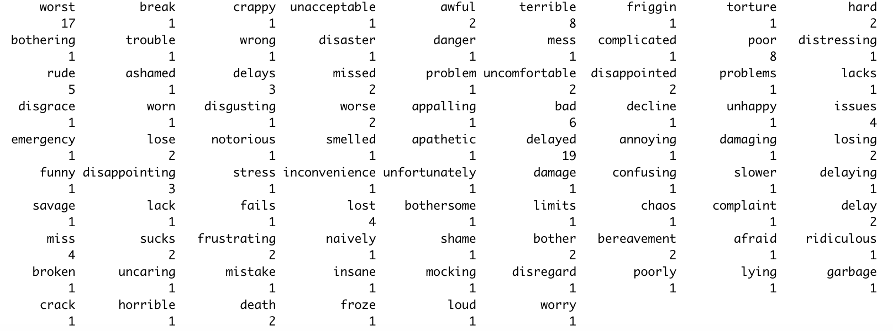
Detractors’ Positive and Negative Words in Airline Review
Positive:
Negative:
As you can see there are a lot more negative words (87) than positive words (47) in the reviews from the detractors. The most common positive words were like, great, well, good, work, and friendly. The most common negative words were worst, rude, terrible, lost, delayed, bad, issues, and poor.
Notes:
posWords <- scan("positive-words.txt", character(0), sep = "\n")
reads in positive words from the positive words text given
negWords <- scan("negative-words.txt", character(0), sep = "\n")
reads in negative words from the positive words text given
posWords <- posWords[-1:-34]
removes first 34 rows from posWords that don't contain words
negWords <- negWords[-1:-34]
removes first 34 rows from negWords that don't contain words
d <- as.matrix(detract_dfm)
converts out detractor document feature matrix into a matrix
dPerWord <- colSums(d)
this sums the columns of our new matrix d so we can see how many times each word occurs
matchedPdetract <- match(names(dPerWord), posWords, nomatch = 0)
this matches words from our dPerWord and posWords, if there is no match there will be a 0
dPerWord[matchedPdetract != 0]
this shows the words that had a match between dPerWord and posWords by showing all the non-zeros in matchedPdetract within dPerWord
sum(matchedPdetract != 0)
shows the amount words matched between dPerWord and posWords
matchedNdetract <- match(names(dPerWord), negWords, nomatch = 0)
this matches words from our dPerWord and negWords, if there is no match there will be a 0
dPerWord[matchedNdetract != 0]
this shows the words that had a match between dPerWord and negWords by showing all the non-zeros in matchedNdetract within dPerWord
sum(matchedNdetract != 0)
shows the amount words matched between dPerWord and negWords

Slide 14
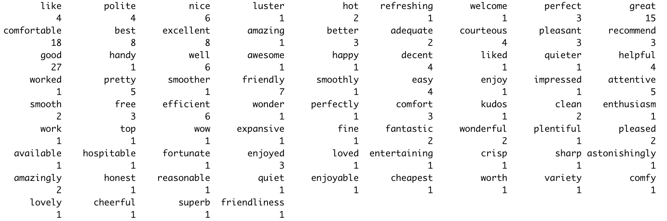
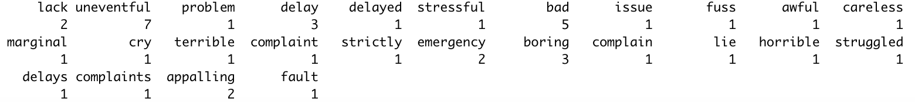
Promoters’ Positive and Negative Words in Airline Review
Positive:
Negative:
Above, you can see that promoters had a lot more positive words (76) than negative words (26) in their reviews. Some of the most common positive words were comfortable, good, best, pretty, nice, excellent, well, efficient, friendly, and great. Some of the most common negative words were uneventful, delay, boring, and bad.
Notes:
posWords <- scan("positive-words.txt", character(0), sep = "\n")
reads in positive words from the positive words text given
negWords <- scan("negative-words.txt", character(0), sep = "\n")
reads in negative words from the positive words text given
posWords <- posWords[-1:-34]
removes first 34 rows from posWords that don't contain words
negWords <- negWords[-1:-34]
removes first 34 rows from negWords that don't contain words
p <- as.matrix(promote_dfm)
converts out promoter document feature matrix into a matrix
pPerWord <- colSums(p)
this sums the columns of our new matrix p so we can see how many times each word occurs
matchedPpromo <- match(names(pPerWord), posWords, nomatch = 0)
this matches words from our pPerWord and posWords, if there is no match there will be a 0
pPerWord[matchedPpromo != 0]
this shows the words that had a match between pPerWord and posWords by showing all the non-zeros in matchedPpromo within pPerWord
sum(matchedPpromo != 0)
shows the amount words matched between pPerWord and posWords
matchedNpromo <- match(names(pPerWord), negWords, nomatch = 0)
this matches words from our pPerWord and negWords, if there is no match there will be a 0
pPerWord[matchedNpromo != 0]
this shows the words that had a match between pPerWord and negWords by showing all the non-zeros in matchedNpromo within pPerWord
sum(matchedNpromo != 0)
shows the amount words matched between pPerWord and negWords

Slide 15
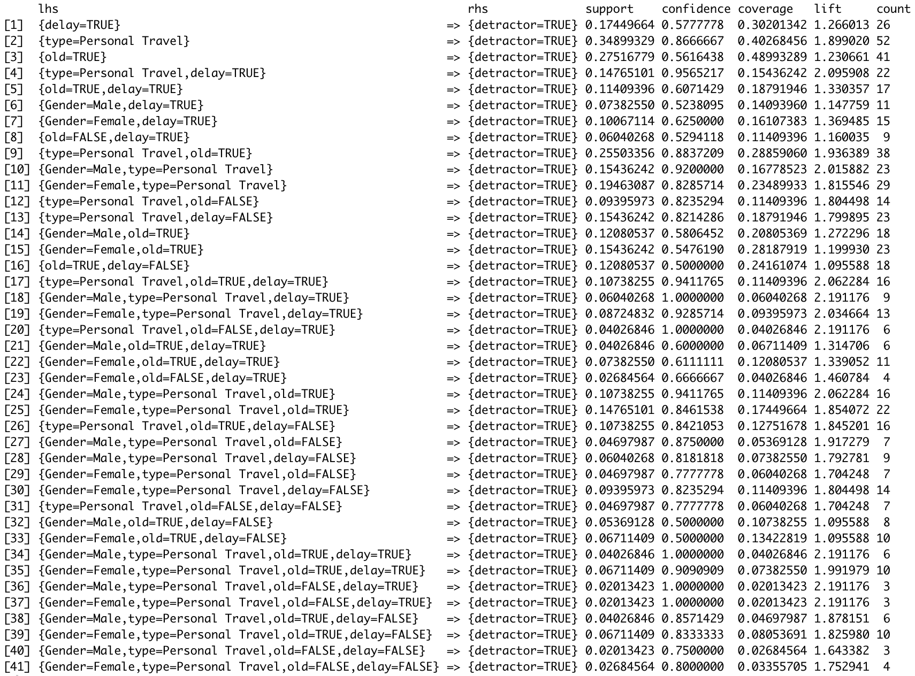
What makes a Detractor?
The two observations I looked at were lines 18 and 20. This is because their confidence was 100% which means that everyone in the data who had those properties was a detractor. Line 18 shows that if the passenger was male, traveled for vacation, and their flight was delayed they were a detractor. Line 20 shows that if you traveled for a vacation, were not old, and there was a delay then you were also a detractor. Both of these rules (lines) have a lift of around 2.19 which is greater than 1 which means that these two occurrences are dependent on one another. The support of line 18 is .06 which means the combination in line 18 appears in 6% of the airline data. The support of line 20 was .04 which means that the combination in line 20 appears in around 4% of the airline data.
Notes:
airCat <- data.frame(Gender=as.factor(airData$gender),
type=as.factor(airData$type_of_travel),
old=as.factor(airData$age>median(airData$age)),
delay=as.factor(airData$departure_delay_in_minutes>15),
detractor=as.factor(airData$likelihood_to_recommend<7))
this creates a data frame from columns in airData and turns them into factors. It also creates three new columns, such as delay
which is defined as a delay in the flight departure by more than 15 minutes, and also a detractor column which is defined by
a passanger giving a rating of less than 7 on the likelihood of recommending this airline. There's also an old column which is defined
by if the age of the passenger is greater than the median of the ages of the passengers in our dataset.
library(arules)
library(arulesViz)
airCatX <- as(airCat,"transactions")
this turns our airCat data frame into transactions so we can inspect it.
ruleset <- apriori(airCatX, parameter=list(support=0.005, confidence=0.5), appearance = list(rhs = "detractor=TRUE"))
this creates a rule set where the support has to be above .005 and the confidence has to be above 0.5, that looks at the properties
of being a detractor.
inspect(ruleset)
this allows you to inspect the results of our ruleset.

Slide 16
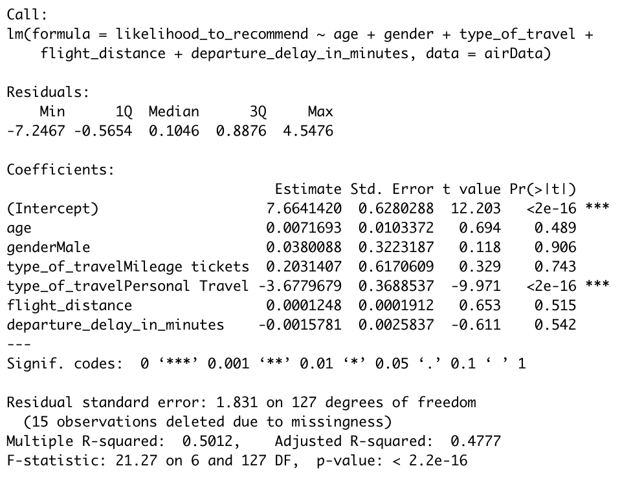
What Changes the Rating of Recommending this Airline the Most?
There is only one significant predictor when looking at what predicts the likelihood of recommending this airline, which is people who traveled for a vacation. This output says that if you traveled for a vacation you are expected to have the worst rating out of the three types of travel. In fact you are expected to have a 3.68 less of a rating compared to someone that traveled for business.
Notes:
recommend_reg <- lm(likelihood_to_recommend ~ age + gender + type_of_travel + flight_distance + departure_delay_in_minutes, data = airData)
this creates a regression with the dependent variable being likelihood to recommend, and the independent variables being age, gender, type of travel,
flight distance, and departure delays.
summary(recommend_reg)
this allows you to see the summary and output of the above regression.
the r-squared is around .47 which isn't great but not terrible, and there is only one significant predictor which is personal travel, which
is significant at the 1st percentile.

Slide 17
Conclusion
Overall I think that this is a pretty good airline. I feel as if there are things that could be improved on, however. When looking at the detractors, their biggest complaints according to the word cloud and sentiment analysis was the service and luggage situation. I would recommend to train the employees at the airport to maximize their friendliness and helpfulness so they can help passengers with their luggage and show them where baggage claim is. I say this because the reason why the promoters gave such a good rating was because of the service according to their word cloud. I think if this airline focuses a lot more on how their employees treat their customers and improve their service then there will be even more promoters in the future.

